Slide 1
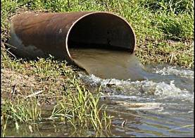
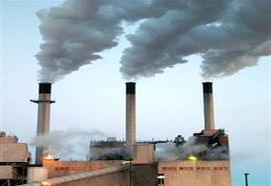
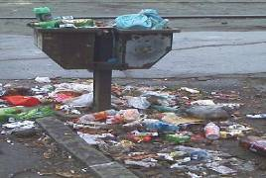
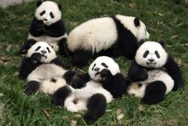

Slide 2
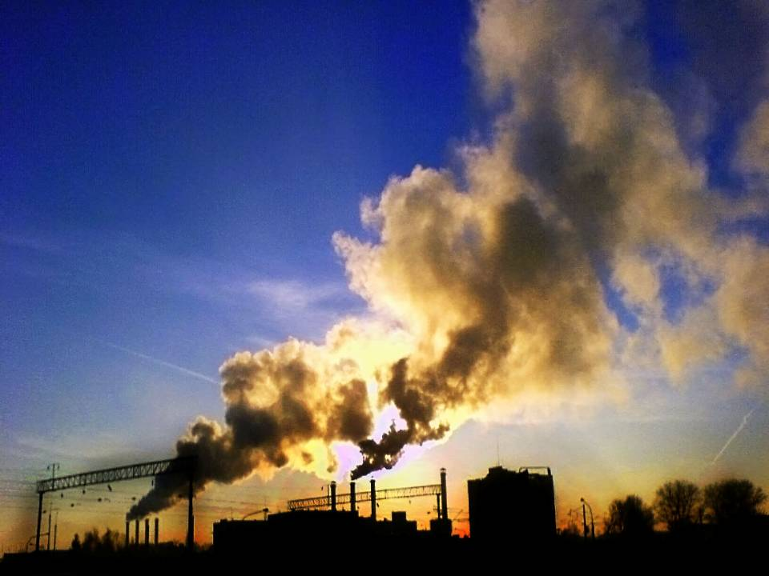
Environmental problems

Slide 3
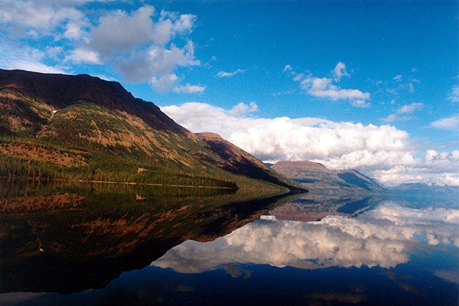
For it we must:
-Revise the words
-Name ecological problems
-Describe ecological signs
-Name ways of solution of environmental problems.

Slide 4
1. Warming up. Quotation
“If you don’t think about
the future
you will not have it.”
John Galsworthy

Slide 5
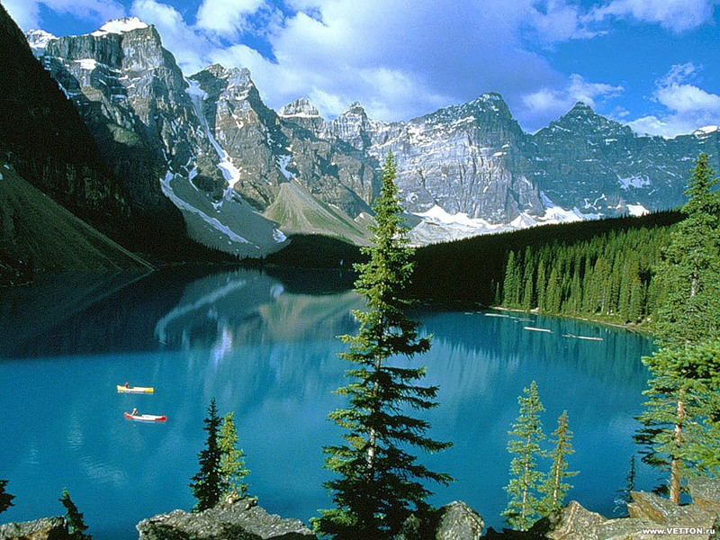

Slide 6
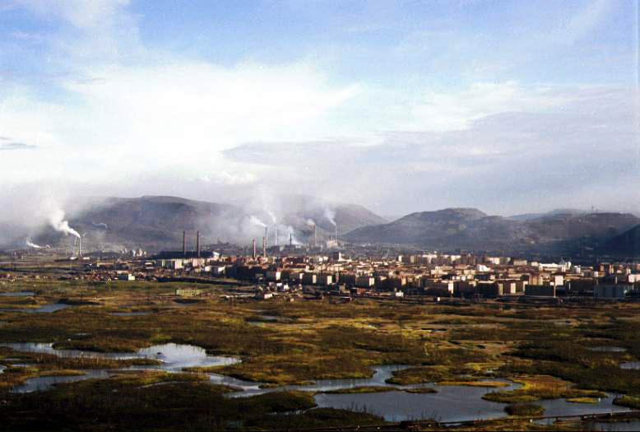

Slide 7
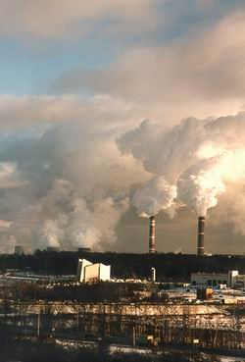
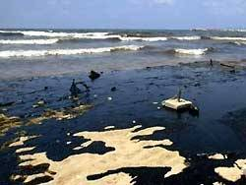

Slide 8
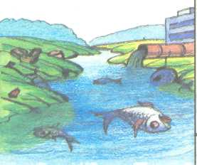


Slide 9
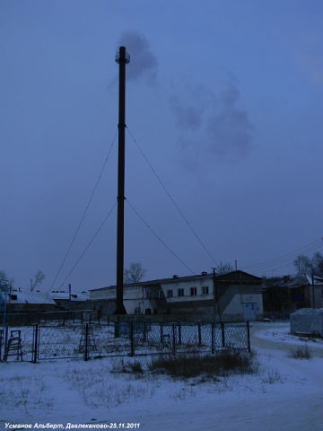
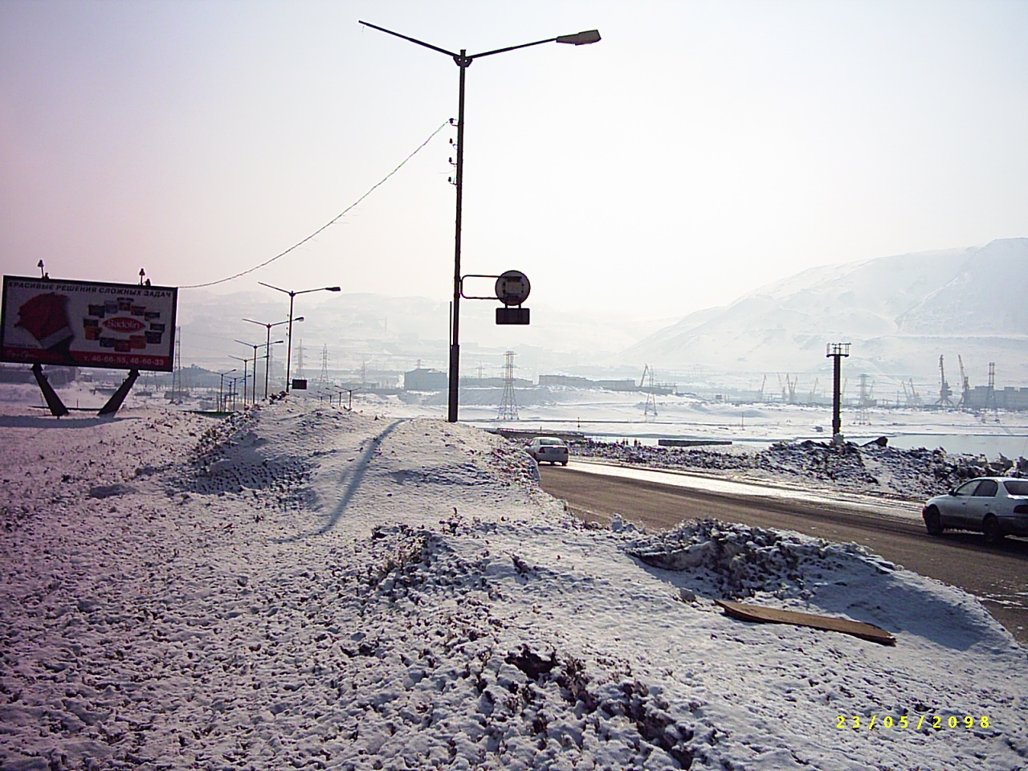

Slide 10
Brush up your vocubulary
Environment
To pollute
Pollution
To cause
Destruction
A shortage
A dump
To dump
Waste
Poison
Nuclear
Weapon
To survive
Safe

Slide 11
guess the world

Slide 12
Решать проблемы окруж. cреды
(to solve environmental problems)
Угрожать жизни людей
(to endanger people’s lives)
Загрязнение водной среды
(water pollution)
Загрязнение воздуха
(air pollution)
Уничтожение живой природы
(destruction of wildlife)
Проводить испытание ядерного оружия
(to test nuclear weapons)
Промышленные и ядерные отходы
(industrial and nuclear waste)
Атомные электростанции
(nuclear power stations)

Slide 13
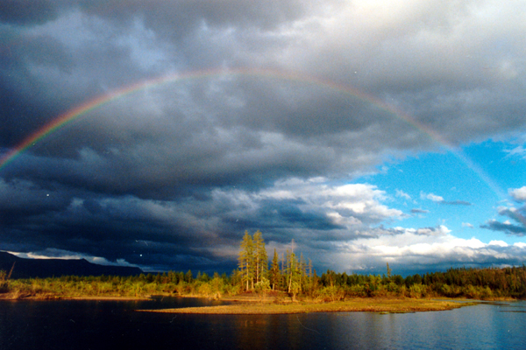

Slide 14
reading

Slide 15
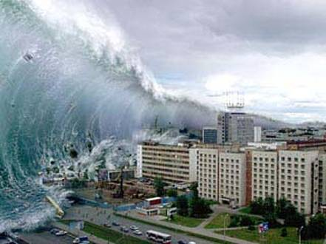
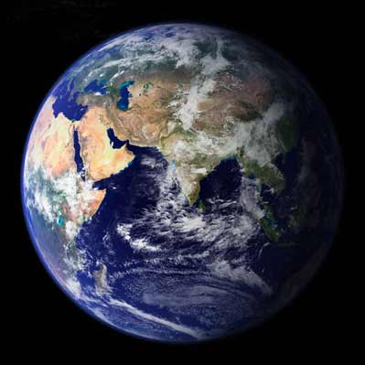
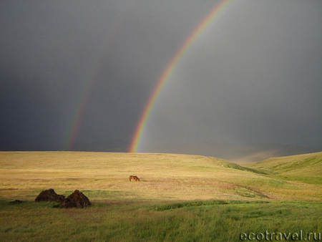
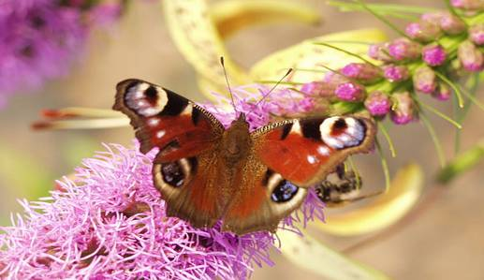
Reports
1 Forests, animals and plants
2 Water pollution
3 Our town

Slide 16
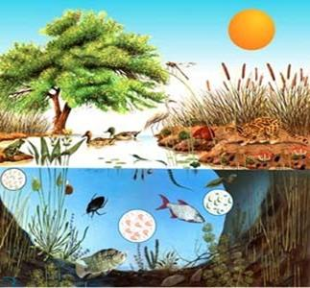
3. WATCING.
3.1. Video “Biotic ecosystem components”

Slide 17
3.2. Make a test:
1. A system formed by the interaction of a community of organisms with its environment
A) Ecosystem
B) Ecology
C) Community
2. The living part of an ecosystem called
A) Living things
B) Species
C) Community
3. All the members of a species in an ecosystem are
A) Living things
B) Biotic
C) Population
4. A community is consists of
A) Living organisms
B) Species
C) Groups of organisms
5. A natural community is consists of
A) Animals and plants
B) Species
C) Groups of organisms
Right answers: 1.A; 2A; 3C; 4C; 5A.

Slide 18
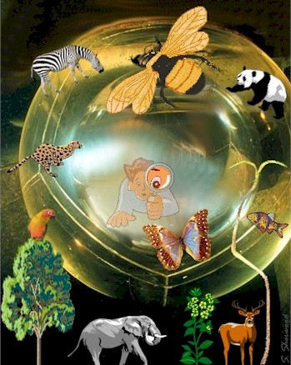
4. TALKING. Are you worried about the nature?

Slide 19
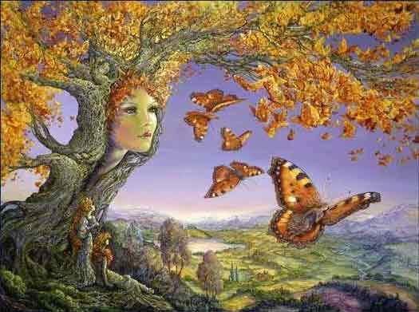
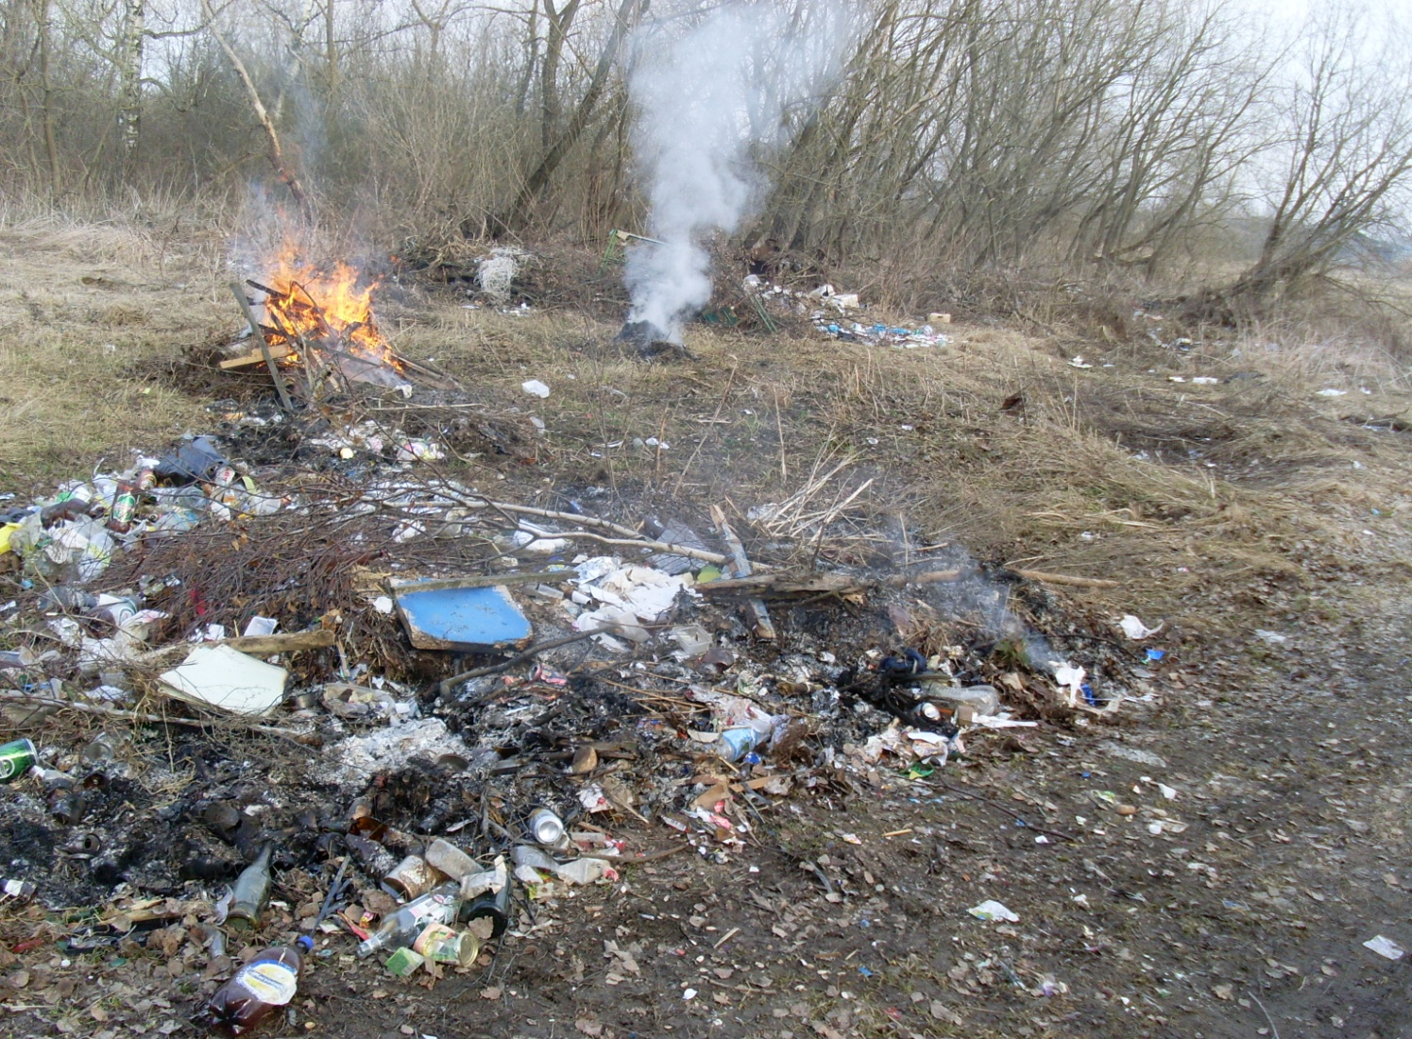
4.4. What should we do to save the nature?

Slide 20
Listen to a song by Louis Armstrong “Wonderful world”
Let`s sing a song together!

Slide 21
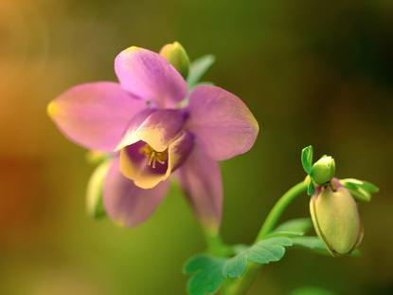
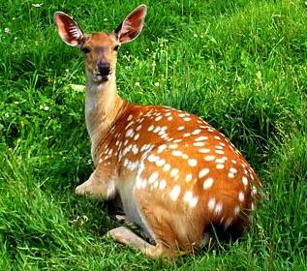
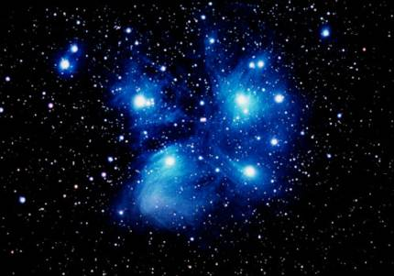
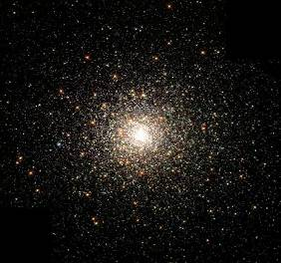
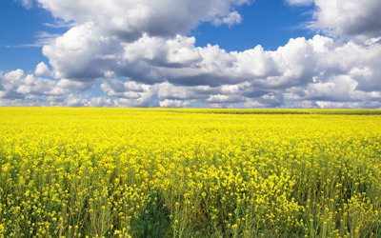
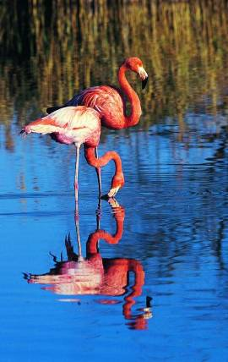

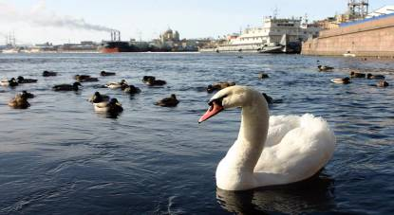

Slide 22

What should and shouldn’t we do to protect our environment?

Slide 23
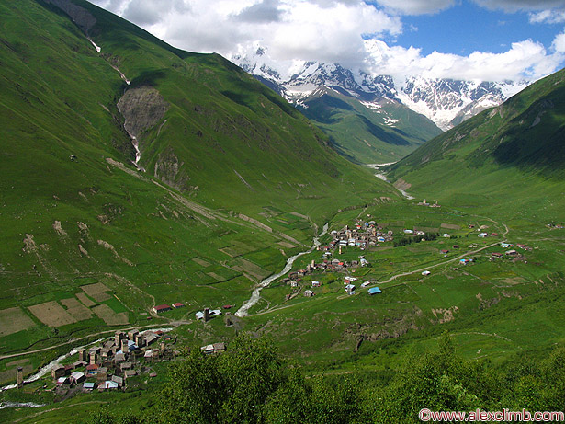
We should
- attract more public attention to environmental problems!
- clean streets and yards regularly!
- use less packaging!
- build recycling factories and recycle waste! - keep the land, air and water clean!
- protect the environment from industrial pollution!
-save water, gas, energy and other natural resources!

Slide 24
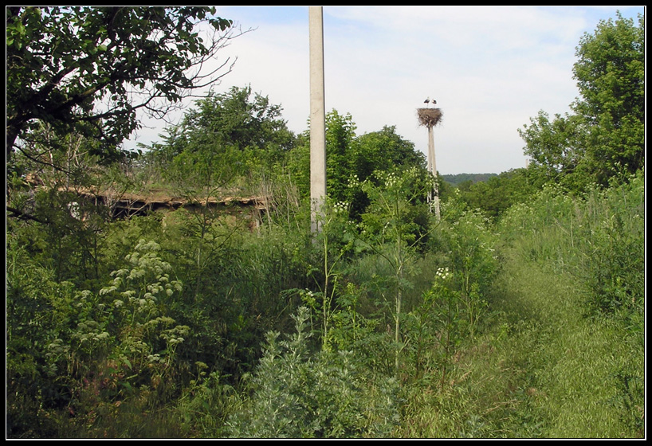
We shouldn’t
- put poisons into the water, air and soil !
- dump industrial waste into rivers, lakes, seas and oceans!
- turn our planet into a pile of rubbish !

Slide 25

Save our planet!

